Slide 1
STEM 1: Introduction
Mrs. Elder

Slide 2
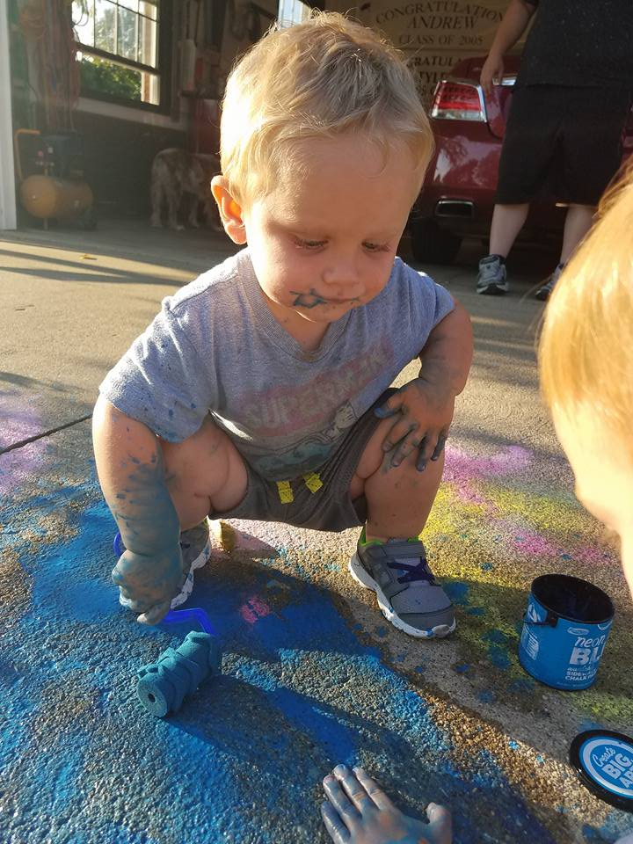
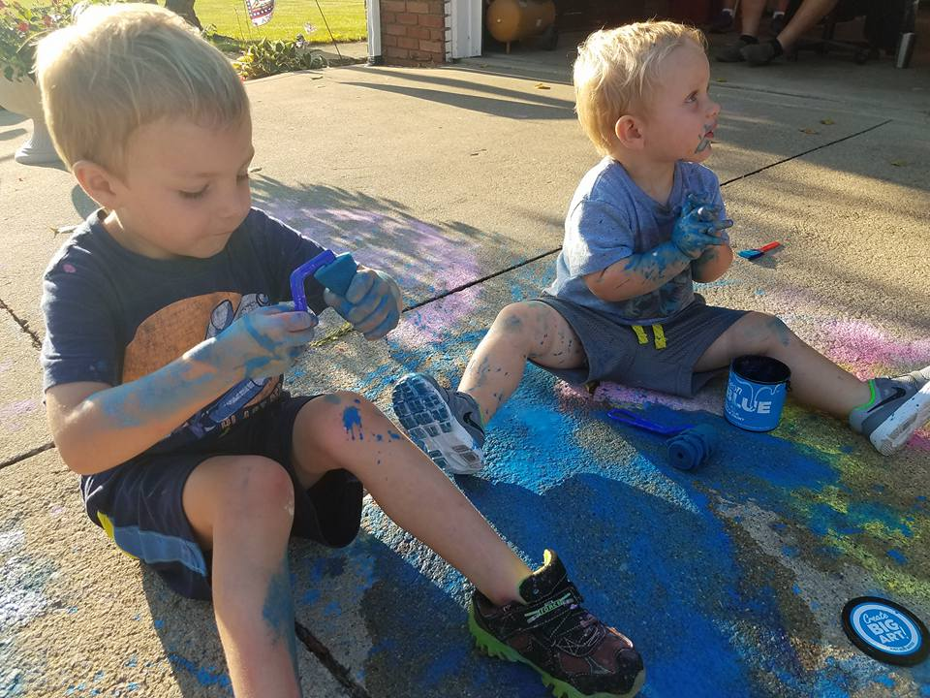
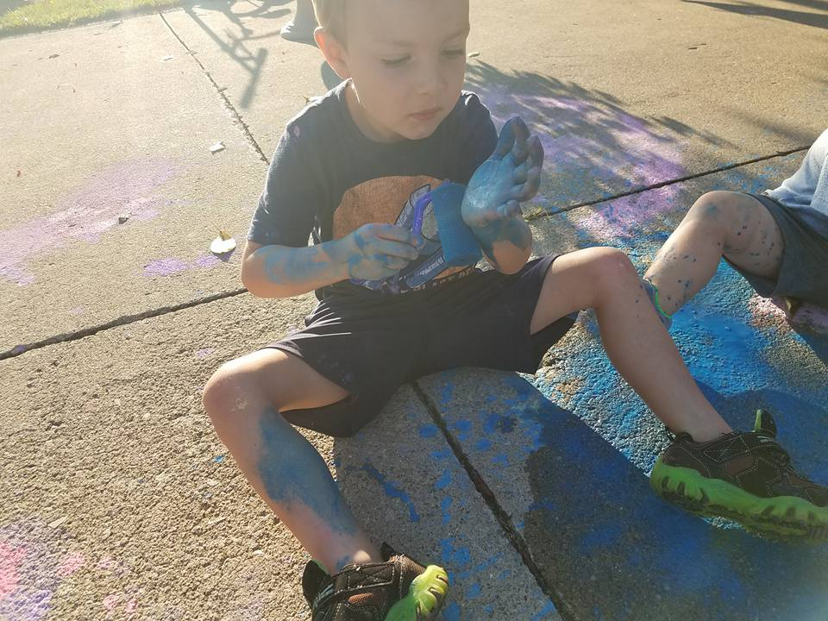

Slide 4
STEM 1
Science
Technology
Engineering
Math
What does STEM mean to you?

Slide 5
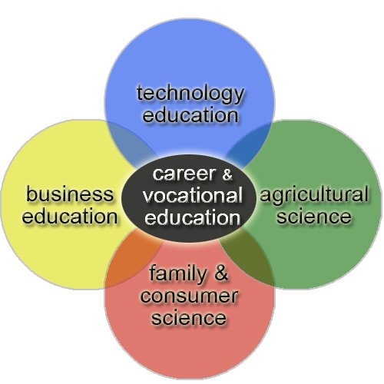
CTE
Career Technical Education
What do you think is the goal of CTE?

Slide 6
Syllabus
Mrs. Elder’s STEM Class
Syllabus and Introductory Letter
Welcome to STEM 1. This is a semester course in which you will learn and use skills in order to prepare and equip you for your future. Many of the skills you use are relevant to in demand careers. This program is a CTE based program, which means that it is a career technical education learning program.
This course is separated into three main parts: modules, project based learning, and focused skills training.

Slide 7
Part 1: Modules
The module portion of this class is an online program in which you will learn, be assessed, and practice hands on skills in many of the following fields:
Alternative Energy
CNC Manufacturing
Electricity
Electronics
Energy, Power, and Mechanics
Engines
Home Makeover
Ideas and Innovations
Immunology
Money Management
Robots
Simple Machines
The modules will be 40% of your overall grade each nine weeks.

Slide 8
Part 2: Project Based Learning
The project portion of the class will include a variety of STEM projects that will be created, explored, researched, and presented. This list includes some of the possible projects or tools that will be used. Some projects will take a few days to complete while other projects may last a couple weeks.
Technology in Careers
How building has changed?
Alternative Energy
3D printing
Laser Engraving
CO2 powered cars
The projects will be 40% of your overall grade each nine weeks.
Part 3: Focused Skills
Focused skill days are each week that is focused on specific skills and concepts that are important for students. These will include engineering, science, computer, and math skills that will be completed by using hands on labs and activities.
The focus skills will be 20% of your overall grade each nine weeks.

Slide 9
Questions?
My website: www. mrselderstem.weebly.com
I am in the process of building my class website. This will be continually updated with resources for your use.

Slide 10
Piece it together
Work together in your groups to put together the puzzle that I have given you. The only rule is that you have to problem solve together and you cannot ask me questions.

